Slide 1

Chapter 10
Query Processing: The Basics

Slide 2
External Sorting
Sorting is used in implementing many relational operations
Problem:
  Relations are typically large, do not fit in main memory
  So cannot use traditional in-memory sorting algorithms
Approach used:
  Combine in-memory sorting with clever techniques aimed at minimizing I/O
  I/O costs dominate => cost of sorting algorithm is measured in the number of page transfers

Slide 3
External Sorting (cont’d)
External sorting has two main components:
  Computation involved in sorting records in buffers in main memory
  I/O necessary to move records between mass store and main memory

Slide 4
Simple Sort Algorithm
M = number of main memory page buffers
F = number of pages in file to be sorted
Typical algorithm has two phases:
  Partial sort phase: sort M pages at a time; create F/M sorted runs on mass store, cost = 2F
Original file
5 3
2 6
1 10
15 7
20 11
8 4
7 5
Partially sorted file
2 3
5 6
1 7
10 15
4 8
11 20
5 7
run
Example: M = 2, F = 7

Slide 5
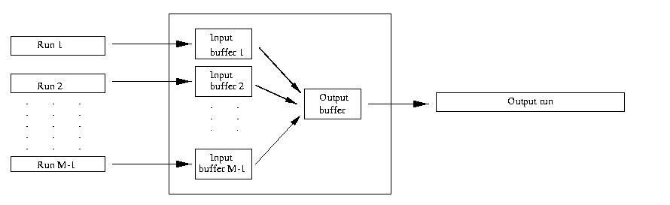
Simple Sort Algorithm
  – Merge Phase: merge all runs into a single run using M-1 buffers for input and 1 output buffer
  • Merge step: divide runs into groups of size M-1 and merge each group into a run; cost = 2F
  each step reduces number of runs by a factor of M-1
Buffer
M pages

Slide 6
Merge: An Example
Input runs
Output run
2 3
5 6
2
5
3
6
10
3
6
1
2
5
7
15
1 2
3 5
6 7
10 15
1 7
10 15
10
1
7
15
Input buffers
Output buffer

Slide 7
Simple Sort Algorithm
Cost of merge phase:
  (F/M)/(M-1)^{k} runs after k merge steps
  ⎡Log _{M-1}(F/M)⎤ merge steps needed to merge an initial set of F/M sorted runs
  cost = ⎡ 2F Log _{M-1}(F/M) ⎤ ≈ 2F(Log _{M-1}F -1)
Total cost = cost of partial sort phase + cost of merge phase ≈ 2F Log _{M-1}F

Slide 8
Duplicate Elimination
A major step in computing projection, union, and difference relational operators
Algorithm:
  Sort
  At the last stage of the merge step eliminate duplicates on the fly
  No additional cost (with respect to sorting) in terms of I/O

Slide 9
Duplicate elimination During Merge
Input runs
Last key used
Output run
2 3
5 6
5
2
3
6
1
2
3
5
6
15
3
6
1
2
5
15
1 2
3 5
6 15
1 3
5 15
1
5
3
15
Key 3 ignored: duplicate
Key 5 ignored: duplicate
Input buffers
Output buffer

Slide 10
Sort-Based Projection
Algorithm:
  Sort rows of relation at cost of 2F Log _{M-1}F
  Eliminate unwanted columns in partial sort phase (no additional cost)
  Eliminate duplicates on completion of last merge step (no additional cost)
Cost: the cost of sorting

Slide 11
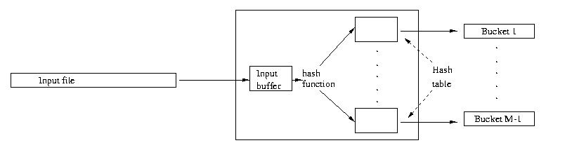
Hash-Based Projection
Phase 1:
  Input rows
  Project out columns
  Hash remaining columns using a hash function with range 1…M-1 creating M-1 buckets on disk
  Cost = 2F
Phase 2:
  Sort each bucket to eliminate duplicates
  Cost (assuming a bucket fits in M-1 buffer pages) = 2F
Total cost = 4F
M pages
Buffer

Slide 12
Computing Selection σ_{(attr op value)}
No index on attr:
  If rows are not sorted on attr:
    Scan all data pages to find rows satisfying selection condition
    Cost = F
  If rows are sorted on attr and op is =, >, < then:
    Use binary search (at log₂ F ) to locate first data page containing row in which (attr = value)
    Scan further to get all rows satisfying (attr op value)
    Cost = log₂ F + (cost of scan)

Slide 13
Computing Selection σ_{(attr op value)}
Clustered B⁺ tree index on attr (for “=” or range search):
  Locate first index entry corresponding to a row in which (attr = value). Cost = depth of tree
  Rows satisfying condition packed in sequence in successive data pages; scan those pages.
  Cost: number of pages occupied by qualifying rows
B⁺ tree
index entries
(containing rows)
that satisfy
condition

Slide 14
Computing Selection σ_{(attr op value)}
Unclustered B⁺ tree index on attr (for “=” or range search):
  Locate first index entry corresponding to a row in which (attr = value).
  Cost = depth of tree
  Index entries with pointers to rows satisfying condition are packed in sequence in successive index pages
    Scan entries and sort record Ids to identify table data pages with qualifying rows
    Any page that has at least one such row must be fetched once.
    Cost: number of rows that satisfy selection condition

Slide 15
Unclustered B⁺ Tree Index
index entries (containing
row Ids) that satisfy
condition
data page
Data file
B⁺ Tree

Slide 16
Computing Selection σ_{(attr = value)}
Hash index on attr (for “=” search only):
  Hash on value. Cost ≈ 1.2
    1.2 – typical average cost of hashing (> 1 due to possible overflow chains)
    Finds the (unique) bucket containing all index entries satisfying selection condition
    Clustered index – all qualifying rows packed in the bucket (a few pages)
    Cost: number of pages occupies by the bucket
    Unclustered index – sort row Ids in the index entries to identify data pages with qualifying rows
    Each page containing at least one such row must be fetched once
    Cost: min(number of qualifying rows in bucket, number of pages in file)

Slide 17
Computing Selection σ_{(attr = value)}
Unclustered hash index on attr (for equality search)
buckets
data pages

Slide 18
Access Path
Access path is the notion that denotes algorithm + data structure used to locate rows satisfying some condition
Examples:
  File scan: can be used for any condition
  Hash: equality search; all search key attributes of hash index are specified in condition
  B⁺ tree: equality or range search; a prefix of the search key attributes are specified in condition
    B⁺ tree supports a variety of access paths
  Binary search: Relation sorted on a sequence of attributes and some prefix of that sequence is specified in condition

Slide 19
Access Paths Supported by B⁺ tree
Example: Given a B⁺ tree whose search key is the sequence of attributes a2, a1, a3, a4
  Access path for search σ_{a1>5 AND a2=3 AND a3=‘x’} (R): find first entry having a2=3 AND a1>5 AND a3=‘x’ and scan leaves from there until entry having a2>3 or a3 ≠ ‘x’. Select satisfying entries
  Access path for search σ _{a2=3 AND a3 >‘x’} (R): locate first entry having a2=3 and scan leaves until entry having a2>3. Select satisfying entries
  Access path for search σ _{a1>5 AND a3 =‘x’} (R): Scan of R

Slide 20
Choosing an Access Path
Selectivity of an access path = number of pages retrieved using that path
If several access paths support a query, DBMS chooses the one with lowest selectivity
Size of domain of attribute is an indicator of the selectivity of search conditions that involve that attribute
Example: σ _{CrsCode=‘CS305’ AND Grade=‘B’} (Transcript)
  a B⁺ tree with search key CrsCode has lower selectivity than a B⁺ tree with search key Grade

Slide 21
Computing Joins
The cost of joining two relations makes the choice of a join algorithm crucial
Simple block-nested loops join algorithm for computing r _{A=B} s
foreach page p_{r} in r do
foreach page p_{s} in s do
output p_{r} _{A=B} p_{s}

Slide 22
Block-Nested Loops Join
If β_{r} and β_{s} are the number of pages in r and s, the cost of algorithm is
    β_{r} + β_{r} ∗ β_{s} + cost of outputting final result
  If r and s have 10³ pages each,
  cost is 10³ + 10³ * 10³
  Choose smaller relation for the outer loop:
    If β_{r} < β_{s} then β_{r} + β_{r}∗ β_{s} < β_{s} + β_{r}∗ β_{s}
Number of scans of relation s

Slide 23
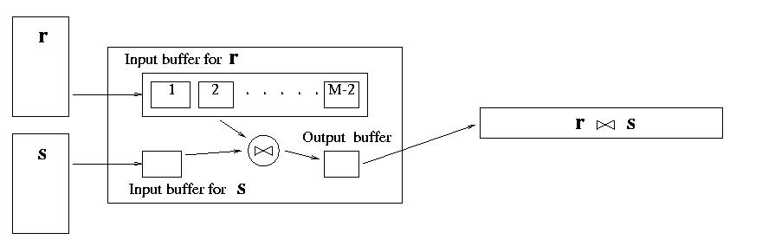
Block-Nested Loops Join
Number of scans of relation s
Cost can be reduced to
β_{r} + (β_{r}/(M-2)) ∗ β_{s} + cost of outputting final result
by using M buffer pages instead of 1.

Slide 24
Block-Nested Loop Illustrated
Input buffer for r
r
r s
s
… and so on
Input buffer for s
Output buffer

Slide 25
Index-Nested Loop Join r _{A=B} s
Use an index on s with search key B (instead of scanning s) to find rows of s that match t_{r}
  Cost = β_{r} + τ_{r} ∗ ω + cost of outputting final result
  Effective if number of rows of s that match tuples in r is small (i.e., ω is small) and index is clustered
  avg cost of retrieving all rows in s that match t_{r}
Number of rows in r
foreach tuple t_{r} in r do {
use index to find all tuples t_{s} in s satisfying t_{r}.A=t_{s}.B;
output (t_{r}, t_{s})
}

Slide 26
Sort-Merge Join r _{A=B} s
sort r on A;
sort s on B;
while !eof(r) and !eof(s) do {
Scan r and s concurrently until t_{r}.A=t_{s}.B=c;
Output σ_{A=c}(r)×σ_{B=c} (s)
}
σ_{A=c}(r)
r
×
s
σ_{B=c} (s)

Slide 27
Join During Merge Illustrated
r
D
A
1 3
p p
0 9
q q
8 7 3
s s s
5 7
u u
1 1
v v
1 3 1 3
p p p p
p p p p
4 0 0 4
8 7 3
s s s
s s s
7 7 7
5 7 5 7 5 7
u u u u u u
u u u u u u
2 2 5 5 0 0
B
E
p p
4 0
r
9
s
7
t t
2 5
u u u
2 5 0
x
0
r _{A=B} s
s

Slide 28
Cost of Sort-Merge Join
Cost of sorting assuming M buffers:
2 β_{r} log _{M-1} β_{r} + 2 β_{s} log _{M-1} β_{s}
Cost of merging:
  Scanning σ_{A=c}(r) and σ_{B=c} (s) can be combined with the last step of sorting of r and s --- costs nothing
  Cost of σ_{A=c}(r)×σ_{B=c} (s) depends on whether σ_{A=c}(r) can fit in the buffer
    If yes, this step costs 0
    In no, each σ_{A=c}(r)×σ_{B=c} (s) is computed using block-nested join, so the cost is the cost of the join. (Think why indexed methods or sort-merge are inapplicable to Cartesian product.)
Cost of outputting the final result depends on the size of the result

Slide 29
Hash-Join r _{A=B} s
Step 1: Hash r on A and s on B into the same set of buckets
Step 2: Since matching tuples must be in same bucket, read each bucket in turn and output the result of the join
Cost: 3 (β_{r} + β_{s} ) + cost of output of final result
  assuming each bucket fits in memory

Slide 30
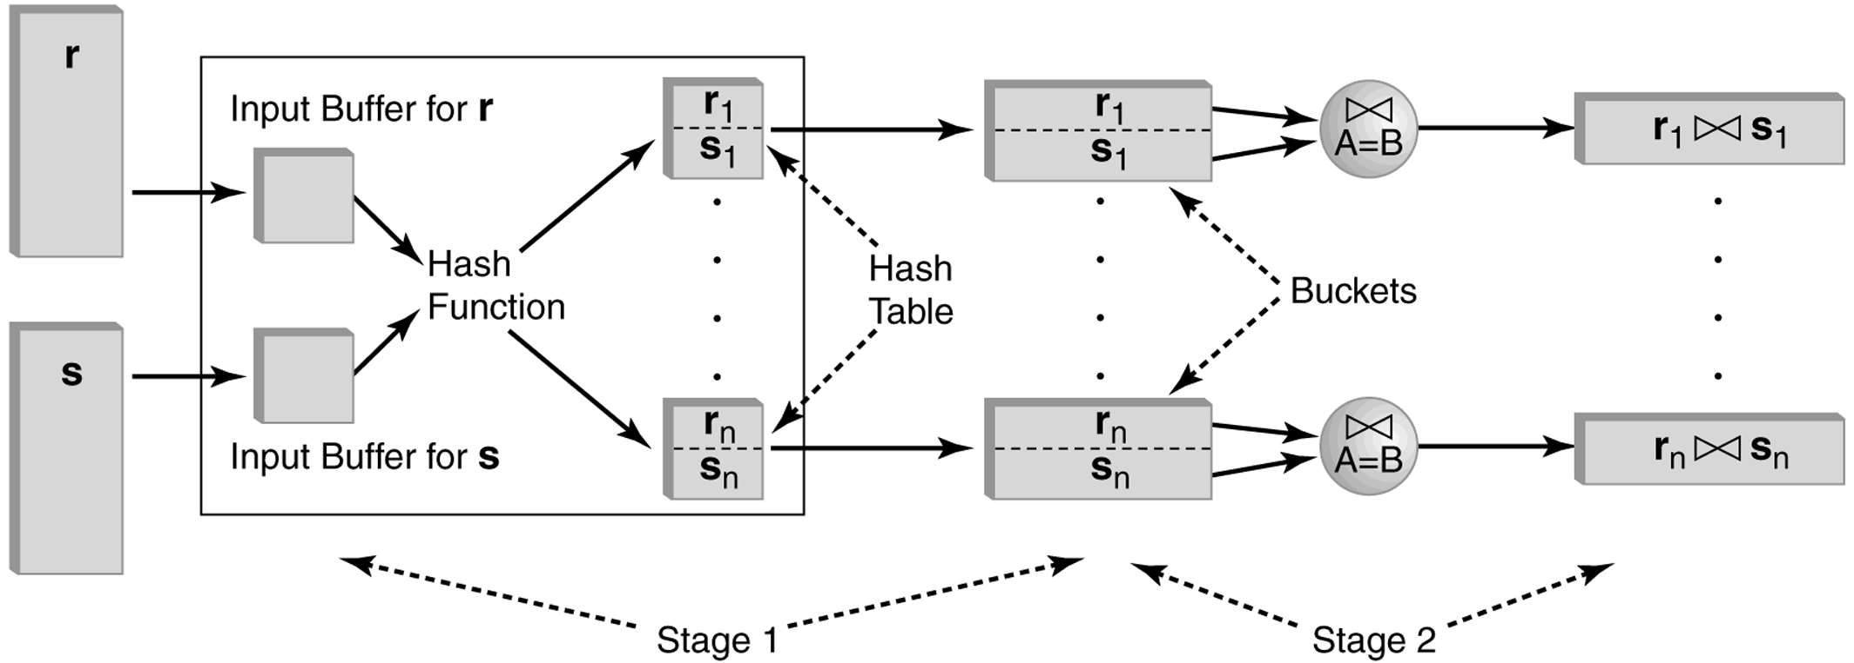
Hash Join

Slide 31
Star Joins
r _{cond1} r₁ _{cond2} … _{condn} r_{n}
  Each cond _{i} involves only the attributes of r_{i} and r
r₂
r₁
cond₁
cond₂
Star relation
Satellite relations
r
cond₅
r₃
cond₃
r₅
cond₄
r₄

Slide 32
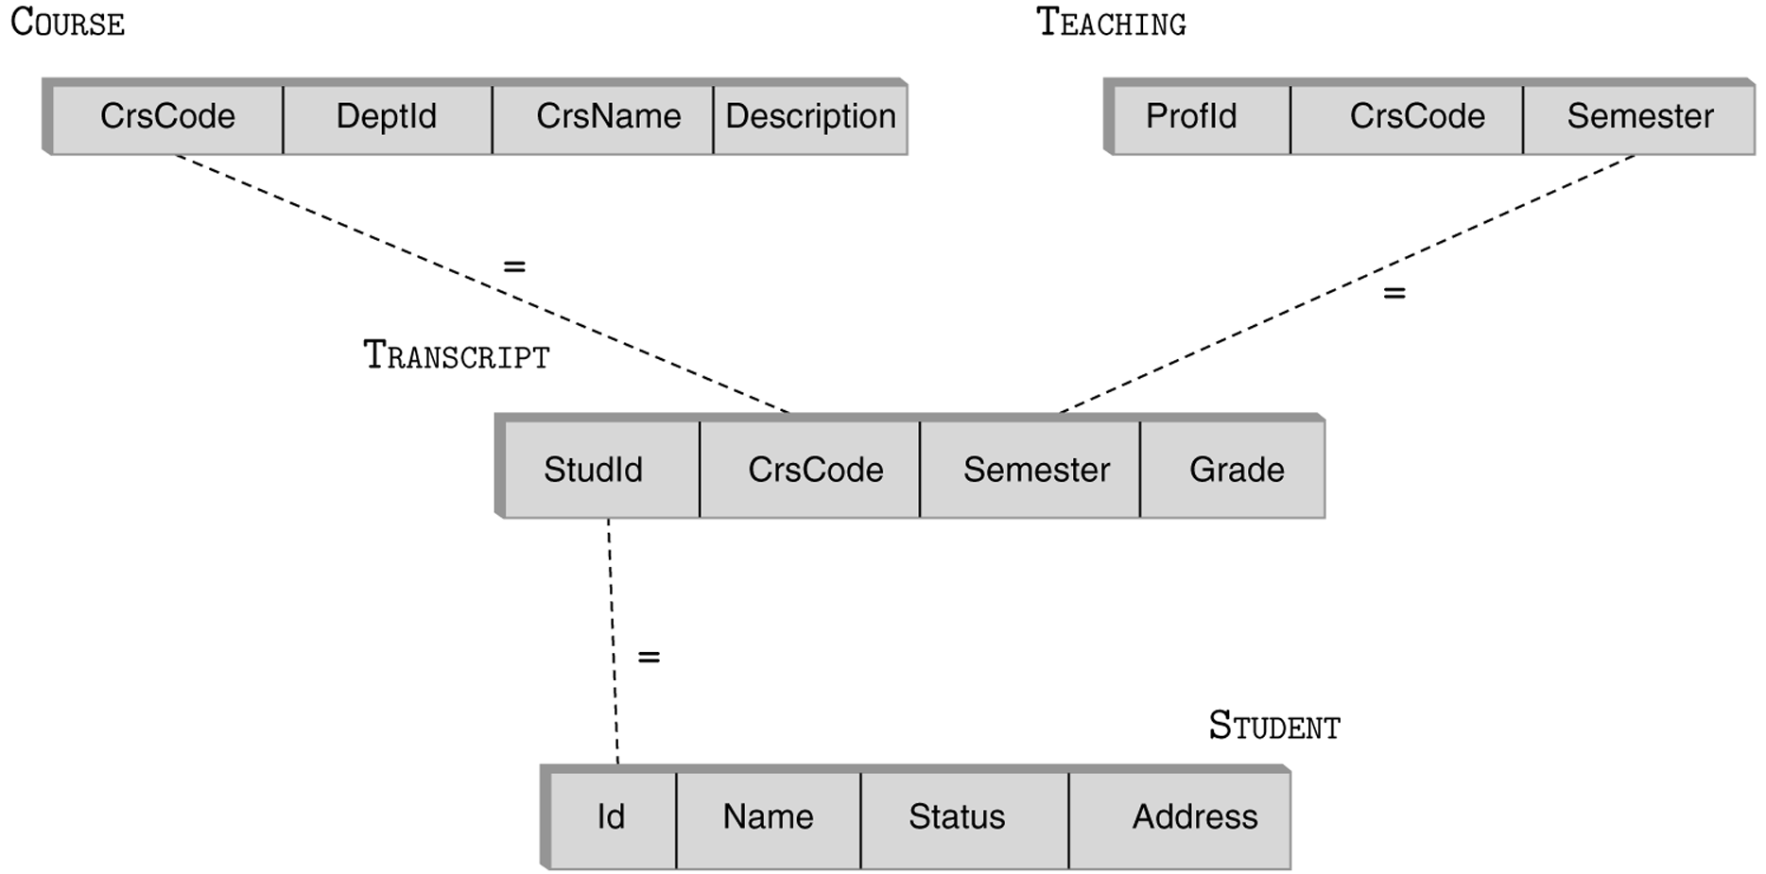
Star Join

Slide 33
Computing Star Joins
Use join index (Chapter 11)
  Scan r and the join index {<r,r₁,…,r_{n}>} (which is a set of tuples of rids) in one scan
  Retrieve matching tuples in r₁,…,r_{n}
  Output result

Slide 34
Computing Star Joins
Use bitmap indices (Chapter 11)
  Use one bitmapped join index, J_{i} , per each partial join
  r _{condi} r_{i}
  Recall: J_{i} is a set of <v, bitmap>, where v is an rid of a tuple in r_{i} and bitmap has 1 in k-th position iff k-th tuple of r joins with the tuple pointed to by v
  Scan J_{i} and logically OR all bitmaps. We get all rids in r that join with r_{i}
  Now logically AND the resulting bitmaps for J₁, …, J_{n}.
  Result: a subset of r, which contains all tuples that can possibly be in the star join
    Rationale: only a few such tuples survive, so can use indexed loops

Slide 35
Choosing Indices
DBMSs may allow user to specify
  Type (hash, B⁺ tree) and search key of index
  Whether or not it should be clustered
Using information about the frequency and type of queries and size of tables, designer can use cost estimates to choose appropriate indices
Several commercial systems have tools that suggest indices
  Simplifies job, but index suggestions must be verified

Slide 36
Choosing Indices – Example
If a frequently executed query that involves selection or a join and has a large result set, use a clustered B⁺ tree index
  Example: Retrieve all rows of Transcript for StudId
If a frequently executed query is an equality search and has a small result set, an unclustered hash index is best
  Since only one clustered index on a table is possible, choosing unclustered allows a different index to be clustered
  Example: Retrieve all rows of Transcript for (StudId, CrsCode)

